Slide 1
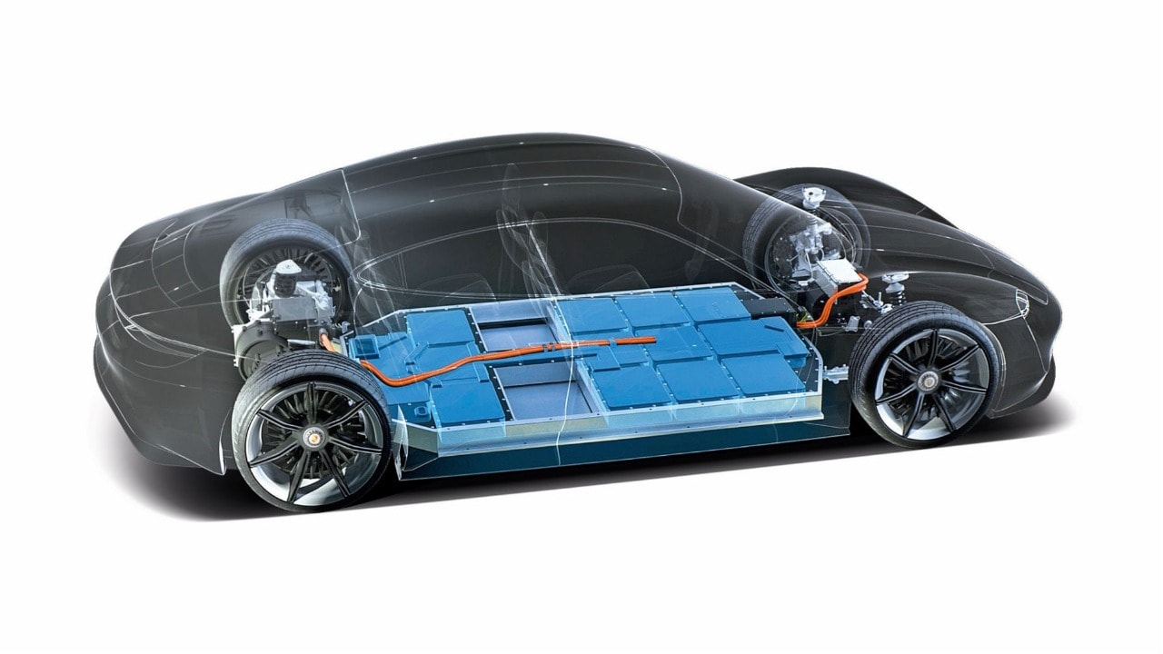
Market Research for Li-ion Battery Procurement – Case Study
DHEEPAK V A

Slide 2
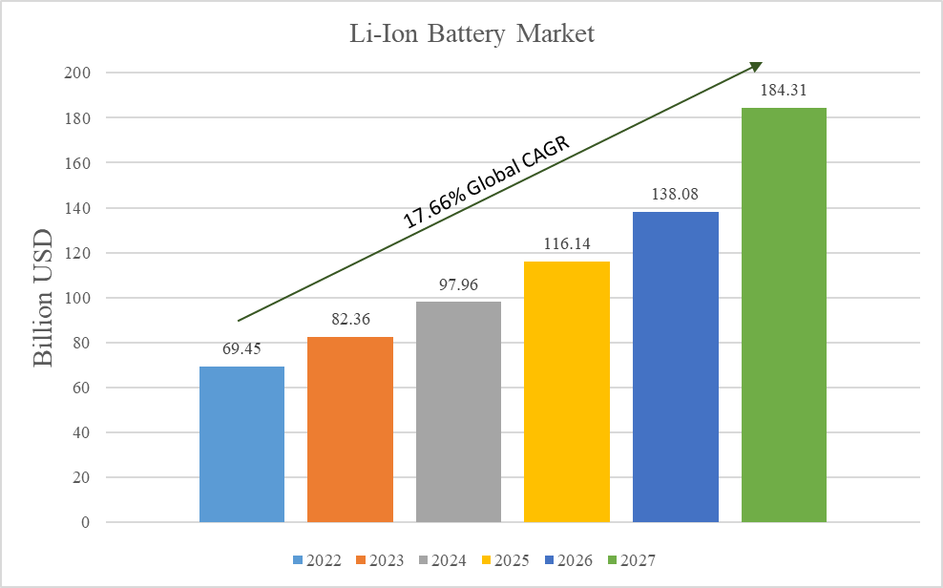
MARKET RESEARCH FOR LITHIUM-ION BATTERY PROCUREMENT
- The approximate size of Li-Ion batteries market (2022 ~ 2027):
The global Lithium-Ion battery market is expected to reach 184.31 Billion USD in 2027 with 17.66% CAGR from 2022 to 2027
The Lithium-Ion battery market in North America is expected to reach 25% CAGR from 2022 to 2027
Source: https://www.precedenceresearch.com/lithium-ion-battery-market &
https://www.mordorintelligence.com/industry-reports/north-america-lithium-ion-battery-market

Slide 3
MARKET RESEARCH FOR LITHIUM-ION BATTERY PROCUREMENT
- Top Li-Ion batteries producing regions (countries) :
Asia Pacific (China, South Korea, Japan, India)
Europe (Germany, France)
North America (USA, Canada, Mexico)
Central America
South America
Middle East
Africa
Source: https://www.grandviewresearch.com/industry-analysis/lithium-ion-battery-market

Slide 4
MARKET RESEARCH FOR LITHIUM-ION BATTERY PROCUREMENT
- Largest buying Sectors / Industries of overall Li-Ion batteries product:
Due to the increase in adoption of Hybrid & Electric Vehicles and usage of Gadgets, the largest buyer of overall Li-Ion batteries product globally will be
1. Automotive Industries
2. Consumer Electronics Industries
Source: https://www.idtechex.com/en/research-article/idtechex-report-reveals-surging-li-ion-battery market/28115#:~:text=Electric%20vehicles%20(EV)%20and%20transportation,%2C%20by%20GWh%2C%20by%202030. &
https://www.transparencymarketresearch.com/lithium-ion-battery-market.html

Slide 5
MARKET RESEARCH FOR LITHIUM-ION BATTERY PROCUREMENT
- Supply base of Li-Ion batteries & Global key suppliers:
The supply base for Li-Ion batteries might be structured in Tiers like Child part suppliers, Module makers and OEMs
Some key suppliers (with origin country) globally includes
1. BYD Company Limited, China
2. LG Chem, South Korea
3. Samsung SDI, South Korea
4. Contemporary Amperex Technology Co. Limited (CATL), China
5. Panasonic Corporation, Japan
Source: https://www.fortunebusinessinsights.com/industry-reports/lithium-ion-battery-market-100123

Slide 6
MARKET RESEARCH FOR LITHIUM-ION BATTERY PROCUREMENT
- Factors that impacts the cost of Li-Ion products:
Raw materials (Lithium, Cobalt, Nickel, Manganese, and Graphite) includes the cost of Mining and Refining which may account approximately 40% of the total cost of product
Manufacturing processes (Assembly, Testing, Quality Control and Packaging)
Research and Development cost to increase efficiency
Transport and Logistics cost
Source: https://content.rolandberger.com/hubfs/07_presse/Roland%20Berger_The%20Lithium-Ion%20Battery%20Market%20and%20Supply%20Chain_2022_final.pdf

Slide 7
MARKET RESEARCH FOR LITHIUM-ION BATTERY PROCUREMENT
- 3 recent industry events that might impacts the cost of Li-Ion products:
The price of battery raw materials fluctuated widely, key pressure is especially high after the recovery from COVID-19 due to demand-supply imbalances
The increasing adoption of recycling technology could reduce the demand for new Li-Ion battery production. But used batteries contain hazardous chemicals like acid and heavy metals such as mercury and lead. A depleted battery holds a residual charge that can cause accidental discharge, damage or injury to property or people. If large lithium-based batteries used for automotive applications are misbranded by local battery manufacturers, while lead-acid batteries can be faulty which needs to be handled
Further to the above, since suppliers are from various regions globally, the competition increases which leads to compromise in price and cost-cutting measures, results in downward pressure on product price
Source: https://content.rolandberger.com/hubfs/07_presse/Roland%20Berger_The%20Lithium-Ion%20Battery%20Market%20and%20Supply%20Chain_2022_final.pdf &
https://www.marketsandmarkets.com/Market-Reports/lithium-ion-battery-recycling-market-153488928.html

Slide 8
Types of challenges would be encountered by Companies in the procurement of Li-Ion products (cost-wise, market risks, supplier-related risks, contractual issues, market predictability etc.)
Cost-wise challenge: The prices of raw materials are volatile and subject to fluctuations, which could impact the cost of the final product. Additionally, the cost of shipping and logistics may also vary depending on the supplier's location and transportation mode
Market risk challenge: The demand for Li-Ion battery is heavily dependent on the demand for end-user products such as Hybrid & Electric Vehicles and Consumer Electronics which may be impacted by economy, technology involved/required, or regulatory factors. Any changes in the market conditions could affect the supply and demand dynamics of the Li-Ion battery market
Supplier risk challenge: Though the suppliers are available from various regions, few key suppliers were dominating the market. There may be issues in quality control, capacity constraints, delay in delivery and logistics issues procuring from the key players. Rather considering to approach for multiple suppliers may benefit with stock or supply back up and lesser risk comparably

Slide 9
Types of challenges would be encountered by Companies in the procurement of Li-Ion products (cost-wise, market risks, supplier-related risks, contractual issues, market predictability etc.)
Contractual issues / challenges: The procurement of Li-Ion batteries may require agreeing various contracts with suppliers which includes price agreements, delivery schedules, quality standards and other legal rights. Any disputes or breaches of contract could result in financial and legal consequences
Market predictability: Though the market is expected to grow rapidly with demand in end-user products, still the Li-Ion market is new and evolving. This could lead to uncertainty and lack of predictability considering the prices, raw materials, supply and demand balance

